Slide 1
DEMAND FORECASTING

Slide 2
Introduction
1

Slide 3
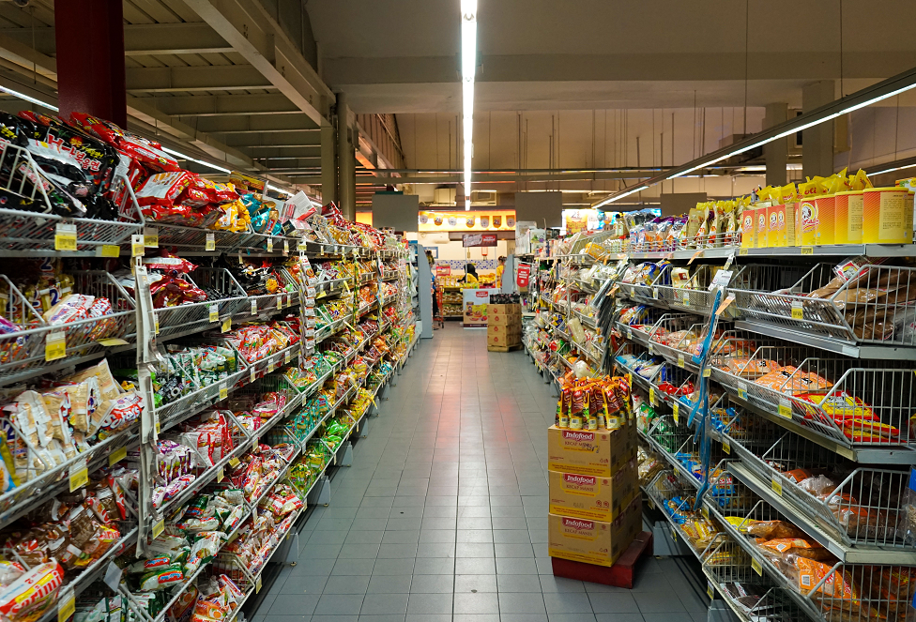
Demand
Demand Amount of product consumer would buy if he could
Availability
Price/Qualities
Measure accuracy

Slide 4
A demand forecast is a firm’s best estimate of what demand will be in the future, given a set of assumptions”
Demand and Supply Integration, the Key to World-Class Demand Forecasting by Mark A. Moon

Slide 5
Forecast assumptions
Internal
Activities put in place to increase demand:
Marketing investments
Promotional activities
New distribution channels
Hire additional sales people
Price
Product features
External
Outside boundaries of company management:
Interest rates,
Unemployment levels,
Inflationary levels
Economical growth
Activity of comptetitors

Slide 6

Stock Keeping Unit
SKU A set of products with same attributes:
Model
Color
Size
tracked for every storage location

Slide 7

Forecast terms
Forecast Level
Forecast Horizon
Forecast Interval
Forecast Form
Granularity
Time frame
How often we collect and measure data
Measure unit

Slide 8
Forecast terms
Forecast Level
Forecast Horizon
Forecast Interval
Forecast Form
Company
Time frame
How often we collect and measure data
Measure unit
Category
Brand
SKU

Slide 9
Forecast terms
Forecast Level
Forecast Horizon
Forecast Interval
Forecast Form
Company
Capacity Adding Time
How often we collect and measure data
Measure unit
Category
Production Lead Time
Brand
SKU

Slide 10
Forecast terms
Forecast Level
Forecast Horizon
Forecast Interval
Forecast Form
Company
Capacity Adding Time
Daily
Measure unit
Category
Weekly
Production Lead Time
Brand
Monthly
SKU

Slide 11
Forecast terms
Forecast Level
Forecast Horizon
Forecast Interval
Forecast Form
Company
Capacity Adding Time
Daily
Kilos
Category
Weekly
Liters
Production Lead Time
Product Units
Brand
Monthly
Money
SKU

Slide 12
Forecast Level hierarchies
Company
Company
Company
Category
Segment
Region
Brand
Customer
Country
SKU
Deliver-To
City
Product
Customer
Location

Slide 13
Forecasting and Collaboration
 | Marketing | Sales | Finance | Sourcing | Logistics | Operations
Needs | Impact of demand generating activities | Allocation of sales resources on markets | Plan for capital allocation and financing needs. | Plan for supply of raw materials, components and products. | Plan allocation and reservation of transport services and warehouses. | Schedule processes and plan activities to meet target demand efficiently in the expected time.
Level | Brand, Product | Brand, Product, Location, Customer | Product, SKU | Product, SKU | Product, SKU, Location | SKU
Horizon | 1 to 2 Quarters | 1 Quarter to 1 Year | 1 Month to 1 Year | Lead time to 2 years | Lead time to 2 years | Lead time to 2 years
Intervals | Quarterly | Quarterly to Annualy | Monthly | Monthly | Monthly | Monthly
Form | Units/Money | Units/Money | Units | Units | Units | Units

Slide 14
Forecast methods
2

Slide 15
Demand Forecast Methods
Quantitavive
Time series Analysis
Regression
Analysis
Horizontal Forecast
Seasonal Forecast
Trend Forecast
Promotion Forecast
Multi SKU Forecast
Linear
Multiple

Slide 16
Demand Forecast Methods
Qualitavive
Market
Survey
Experts consensus
Delphi
Sales Force

Slide 17

Time Series Analysis
What happened in the past follows patterns what most likely will apply in similar way in the future.

Slide 18
Demand Graph

Slide 19
Demand Graph
Time Series

Slide 20
Demand Graph
Time Series points in time at fixed intervals (e.x. every end of month)

Slide 21
Demand Graph
Demand quantity of products

Slide 22
Demand Graph

Slide 23
Demand Graph
Let’s assume first month we measure demand for a product is March 2020

Slide 24
Demand Graph
Demand at 31/03/2020
X(1) = 54 products
Let’s assume first month we measure demand for a product is March 2020

Slide 25
Demand Graph
Demand at 30/04/2020
X(2) = 74 products
We measure same data on the end of following month (April 2020)

Slide 26
Demand Graph
We collect demand for enough long time to have valuable statistics ...

Slide 27
Demand Graph
..so that we can forecast at time x(20) what will be demand in x(21)

Slide 28
Demand Graph
In longer time horizon we collect both Real and Forecasted Demand

Slide 29
Demand Graph
Spread between Real and Forecasted demand is called noise

Slide 30
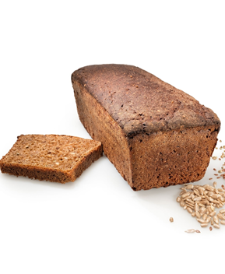
Horizontal Demand Forecast

Slide 31
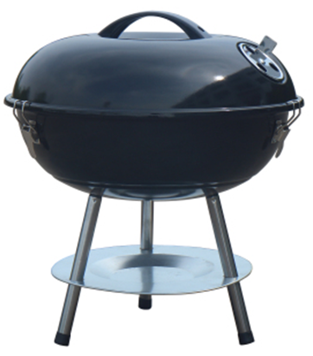
Seasonal Demand Forecast

Slide 32

Trend Demand Forecast

Slide 33

Promotion Demand Forecast

Slide 34

Multi SKU Demand Forecast

Slide 35

Regression Analysis
demand depends on
measurable fluctuations of correlated indipendent variables

Slide 36
Linear Regression Analysis

Slide 37
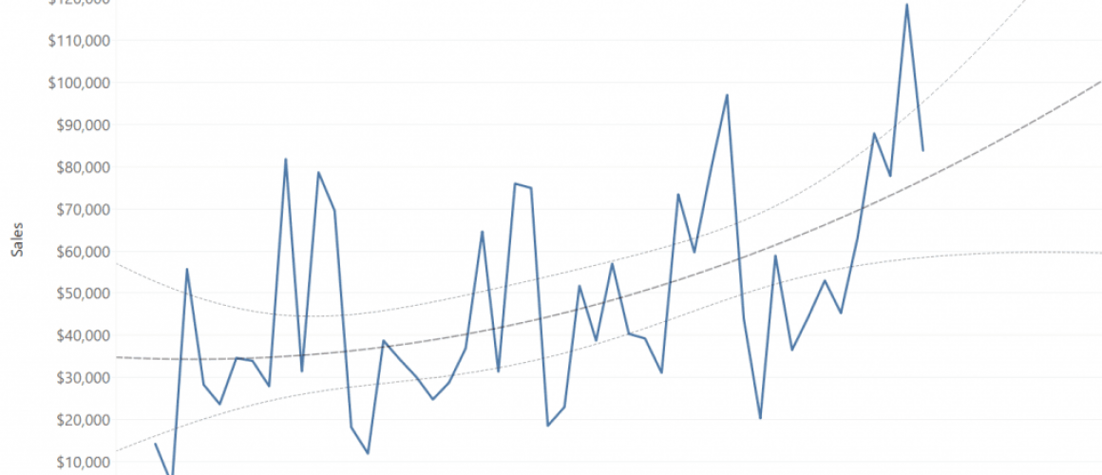
Multiple Regression Analysis

Slide 38

Qualitative analysis
Constantly monitor and evaluate
Informations coming from markets

